Slide 1
Thinkful Supervised Learning Capstone: Predicting the Age of Abalone through Physical Measurements Sean Bohan
April 2018

Slide 2
Introduction
Problem: Predicting Abalone age based on physical measurements
Practical Uses: Age determined by cutting the shell, staining it, and counting the number of rings through a microscope
Time-consuming and Pain-staking
Requires killing Abalone
Limitations: Does not include information regarding weather patterns and location (i.e. food availability) which may be necessary to solve problem
Source:https://archive.ics.uci.edu/ml/datasets/Abalone
Warwick J Nash, Tracy L Sellers, Simon R Talbot, Andrew J Cawthorn and Wes B Ford (1994) "The Population Biology of Abalone (_Haliotis_ species) in Tasmania. I. Blacklip Abalone (_H. rubra_) from the North Coast and Islands of Bass Strait", Sea Fisheries Division, Technical Report No. 48 (ISSN 1034-3288)

Slide 3
The Data
Target Variable: Rings (proxy for age)
Number of Instances: 4177
Dependent Variables: 8
Missing Values: None (previously cleaned)
Name | Data Type | Meas. | Description
Sex | categorical |  | M, F, I (Infant)
Length | continuous | mm | Longest shell measurement
Diameter | continuous | mm | perpendicular to length
Height | continuous | mm | with meat in shell
Whole Weight | continuous | grams | whole abalone
Shucked Weight | continuous | grams | weight of meat
Viscera Weight | continuous | grams | gut weight
Shell Weight | continuous | grams | after being dried

Slide 4
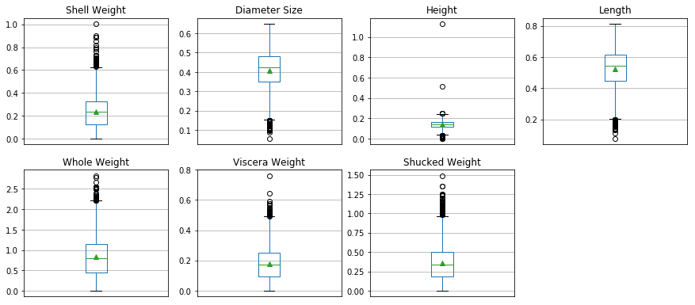
Data Exploration
Indication of outliers in each of my variables – evidence for potential removal

Slide 5
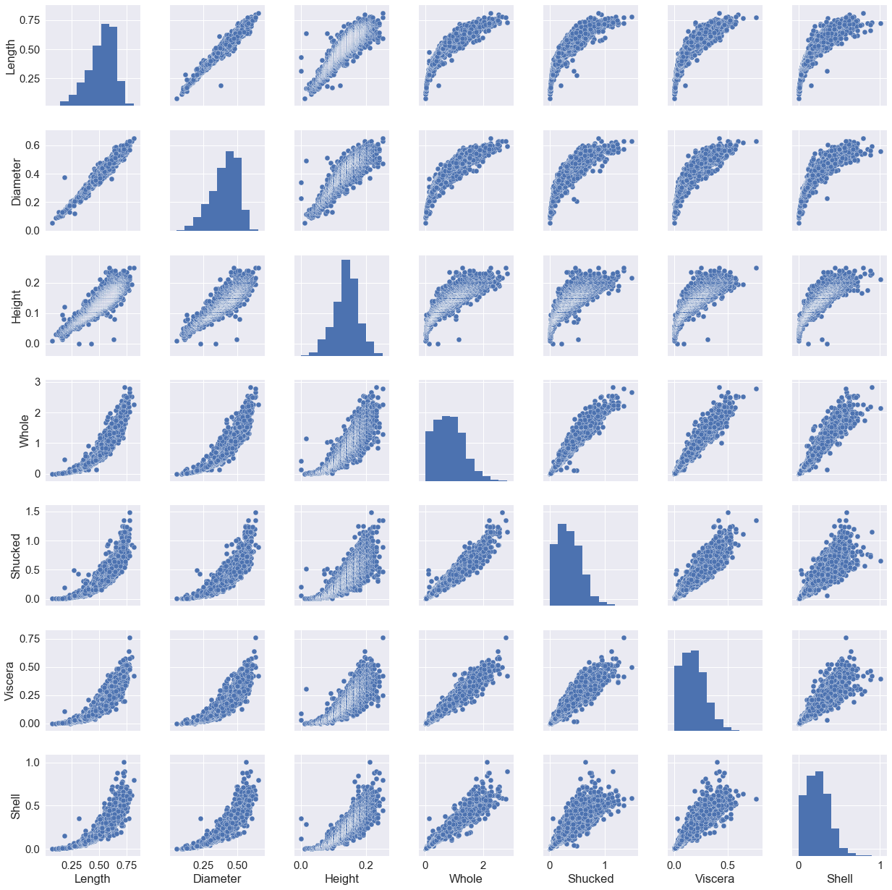

Slide 6
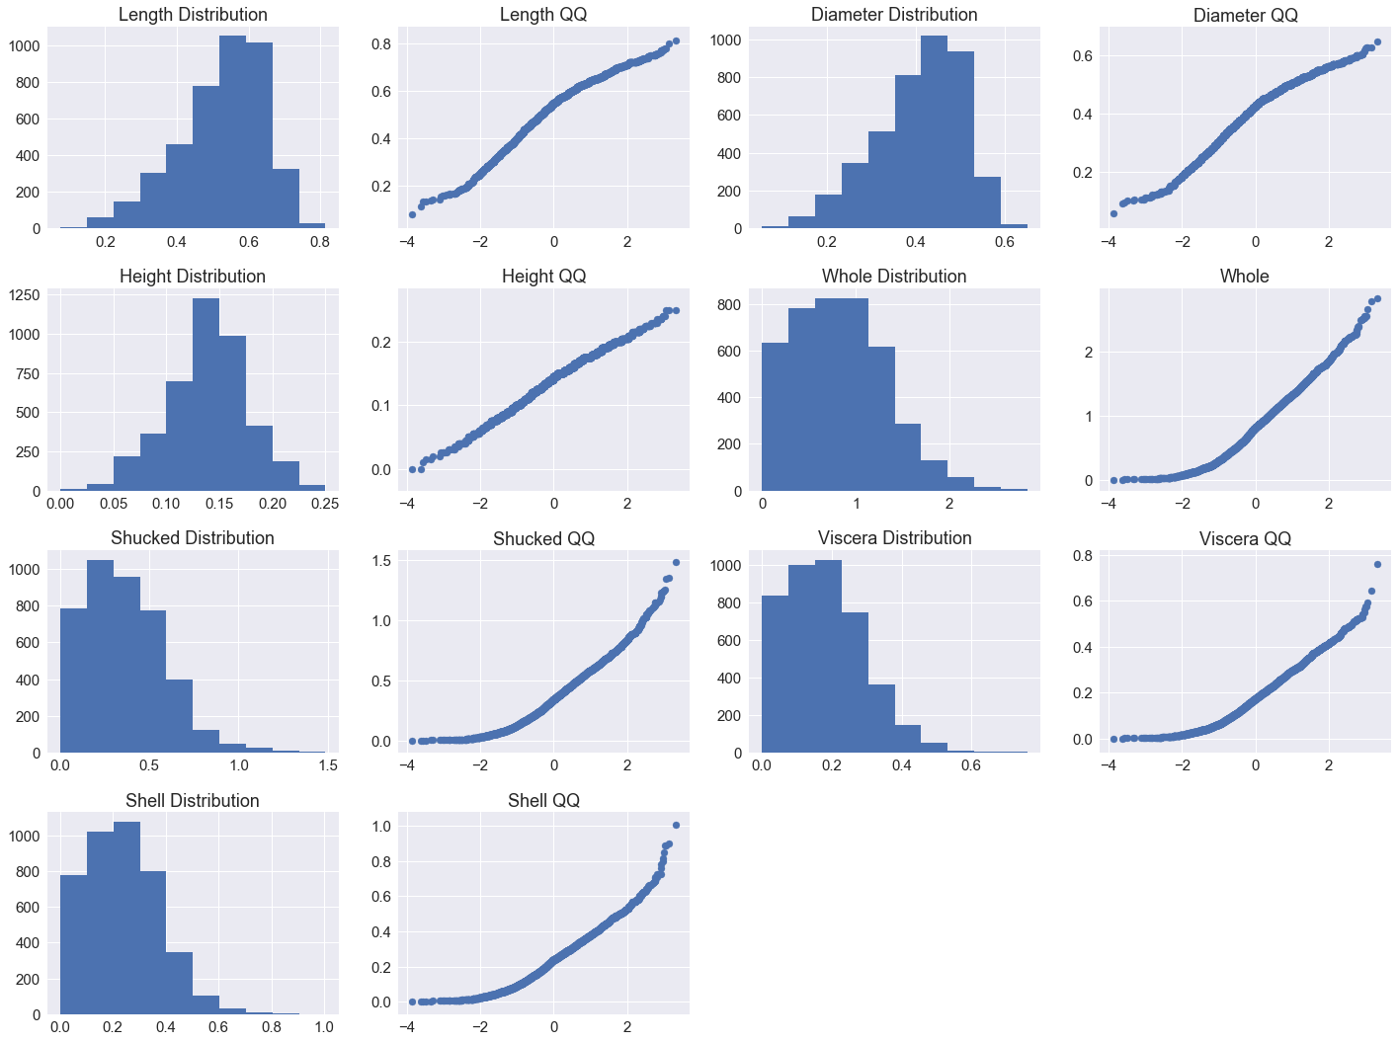
Distribution Examination with QQ plots
Notes:
SLIGHT SKEW BUT MOSTLY NORMAL LOOKING
GOOD BENEFIT FROM TRANSOFMRATIONS

Slide 7
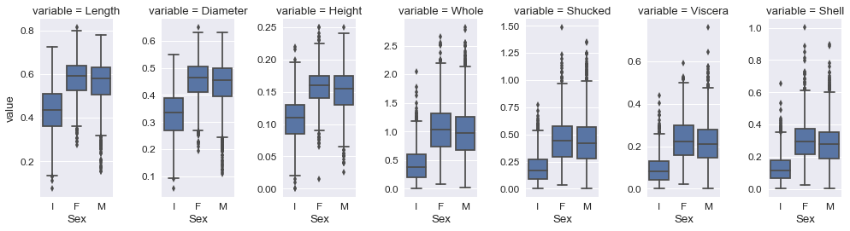
Relationship between Continuous and Categorical Feature, Sex
Distributions for Female and Male similar for each continuous variables, while Infant Abalone have a different distributions of the data points

Slide 8
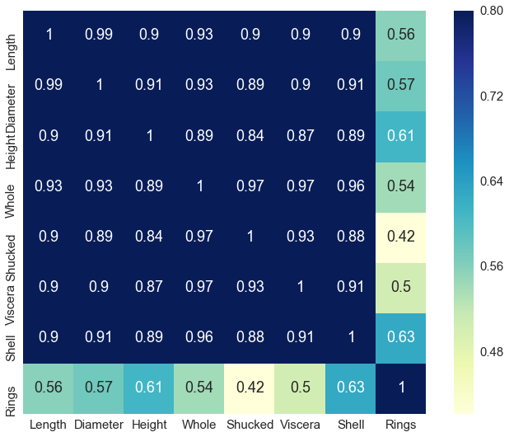
Feature Correlation
High Correlation among features – likely sign of Multicollinnearty

Slide 9
Baseline Scores/ Model Approaches and Techniques
RMSE (predicting mean value): 3.224
ACCURACY (predicting median value): 0.165
PARAMETERS/APPROACH:
Primary Models: Linear, Random Forest, Gradient Boosting, SVM
Other Models: Ridge Regression, KNN
Parameter selection: Grid Search (for all but Linear and Ridge models)
Scores
R² for train and test sets (split size of 20%)
Cross Validation R² (using Kfold technique with n_splits of 10)
RMSE

Slide 10
Modeling – Attempt 1
Using original 8 features, without any engineering or transformation
Model | R² Test Set | R² Train Set | Cross Validation R² | RMSE | Improvement over BL RMSE
Vanilla Linear | 0.584 | 0.525 | 0.541 | 2.183 | 32.29%
Random Forest | 0.57 | 0.743 | 0.558 | 2.144 | 33.50%
Ridge | 0.584 | 0.525 | 0.541 | 2.185 | 32.23%
KNN | 0.528 | 0.599 | 0.542 | 2.182 | 32.32%
Gradient Boost | 0.573 | 0.657 | 0.553 | 2.157 | 33.10%
SVM | 0.603 | 0.604 | 0.554 | 2.154 | 33.19%
Notes:
Overfitting in random forrest and gradient boost
All show imoprovments over baline rmse

Slide 11
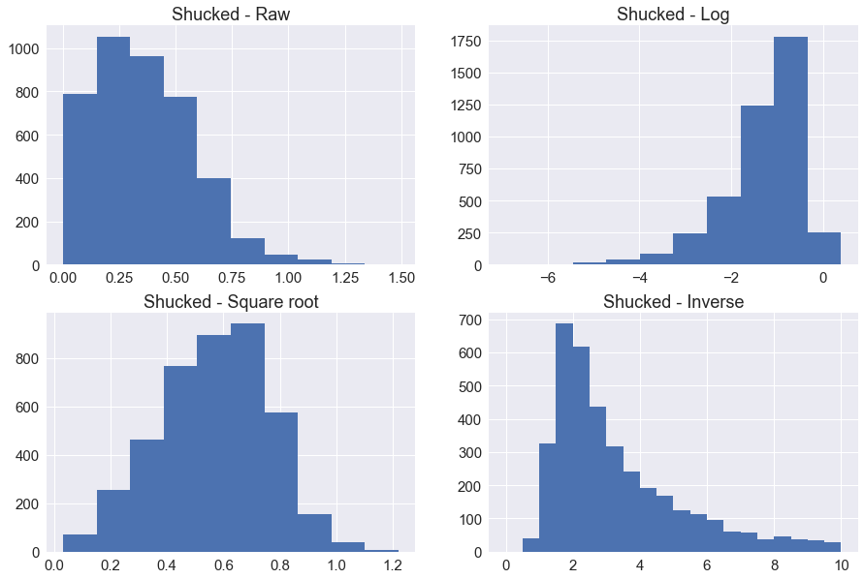
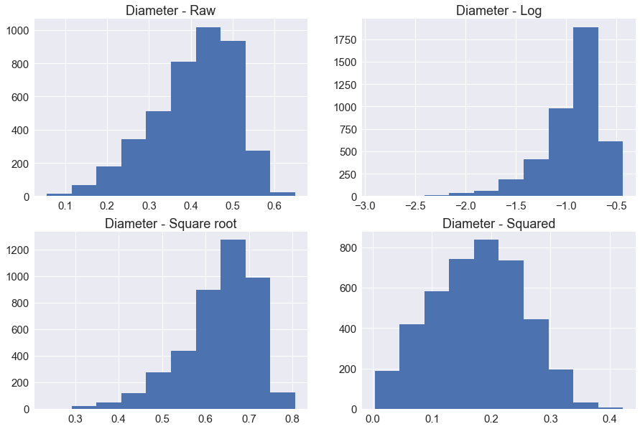
Feature Transformation
Looked at variety of transformation and impact on distribution of features
Notes:
Transformed most of the features by taking the square root, or square

Slide 12
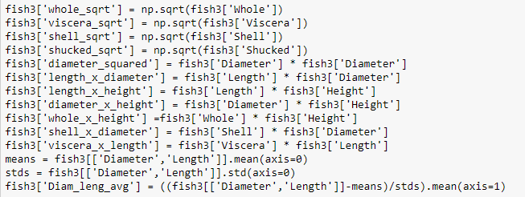
Feature Transformation Cont.
Given shared correlation among features, created new ‘interaction’ features

Slide 13
Modeling – Attempt 3
Added feature transformations and created additional features – small improvements across majority of scores
Model* | R² Test Set | R² Train Set | Cross Validation Predict R² | RMSE | Improvement over Model 1 RMSE
Vanilla Linear | 0.593 | 0.569 | 0.567 | 2.121 | 2.84%
Random Forest | 0.572 | 0.755 | 0.557 | 2.146 | -0.09%
Gradient Boost | 0.574 | 0.661 | 0.555 | 2.150 | 0.32%
SVM | 0.598 | 0.596 | 0.554 | 2.154 | 0.00%
Notes:
Overfitting in random forrest and gradient boost
All show imoprovments over baline rmse

Slide 14
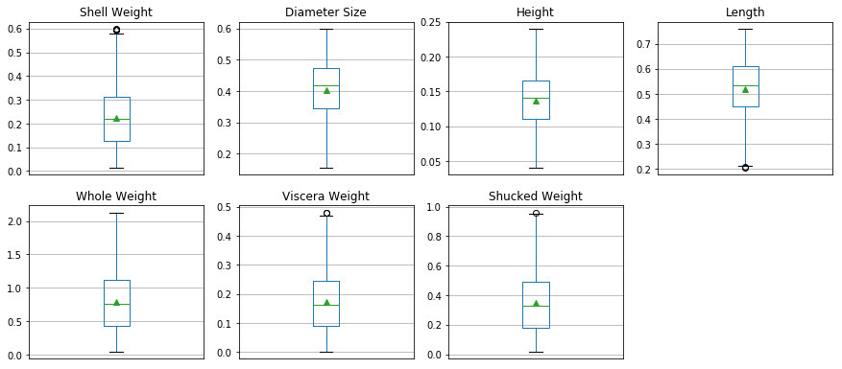
Next Attempt – Removing Outliers
Removed outliers (points 1.5 * IQR above and below 3rd and 1st quartiles)

Slide 15
Modeling – Attempt 5
Removed outliers and added additional features and transformations– improved test set R² , albeit a lower RMSE (yet still better than Baseline)
Model* | R² Test Set | R² Train Set | RMSE | Improvement over Model 3 RMSE | Improvement over Model 1 Test Set R²
Vanilla Linear | 0.604 | 0.544 | 2.128 | -0.33% | 1.85%
Random Forest | 0.594 | 0.75 | 2.155 | -0.42% | 3.85%
Gradient Boost | 0.59 | 0.718 | 2.164 | -0.65% | 2.79%
SVM | 0.593 | 0.574 | 2.157 | -0.14% | -0.84%
Notes:
Overfitting in random forrest and gradient boost
All show imoprovments over baline rmse

Slide 16
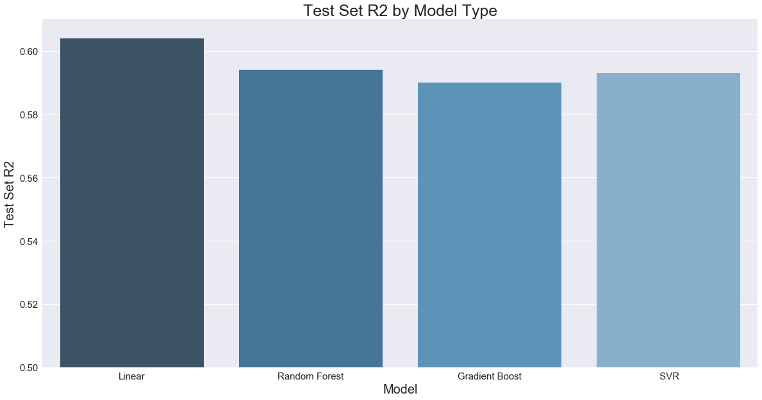
Model 5 Model Comparison
Random Forest and Gradient Boost tended to have higher test set and cross val predict R² scores compared to linear and SVR models

Slide 17
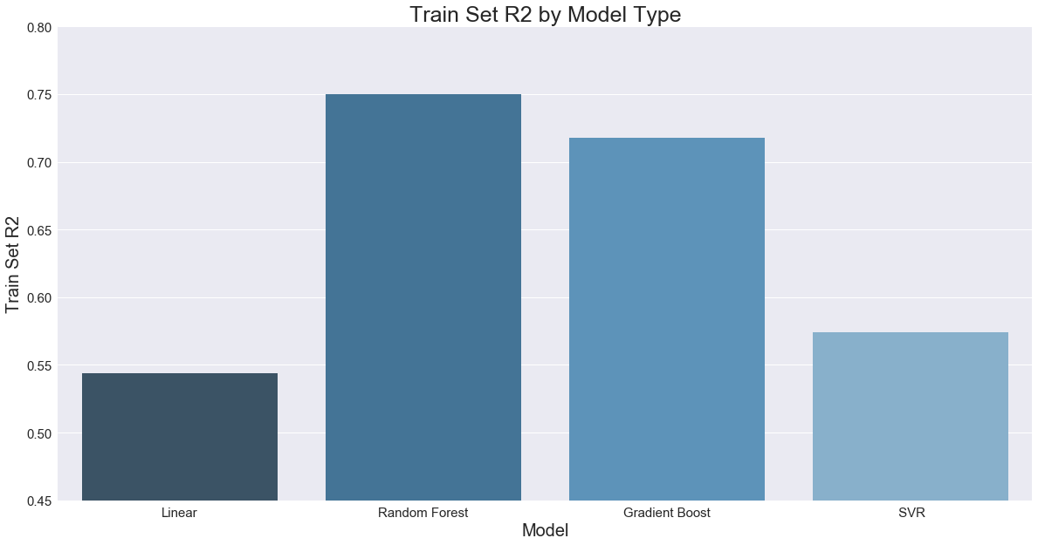
Model 5 Model Comparison
However, based on the train set scores of the RF and GB models, there appears to be a case of overfitting, which is not evident in linear and SVR models

Slide 18
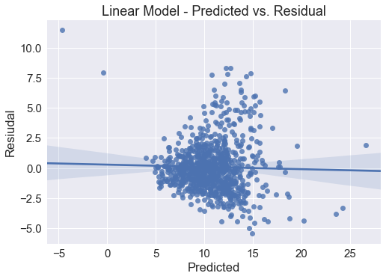
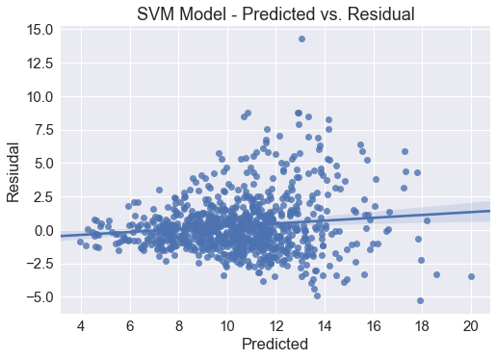
Residual Inspection
Despite Higher R² for Linear Model, examination of residuals show outliers and evidence of heteroscedasticity for this model compared to the SVM model

Slide 19
Conclusions/Future Work
Conclusions: Model Choice - SVM
Models perform similarly to each other across each attempt
Linear model and SVR model did not show evidence of overfitting
While Linear model showed highest test set R² and lowest RMSE for final attempt, inspection of residuals showed that linear model suffered from heteroscedasticity
Feature engineering tended to have less impact on performance, prior to removing outliers
When looking at residuals, evidence that improvements still possible
Future Tuning:
Look into additional models
Feature Selection Techniques (i.e. feature importance, PCA, recursive feature elimination)
Additional Feature Engineering (more interaction features)
Work to improve underestimation for higher number of rings and fix multicollinearity and heteoscedasticity

